Slide 1
Team Project: Building a Multi‑source Dataset on Food Prices, Energy and Logistics (2018–2025)
Econ 7900 — Statistics for Data Science | ~15‑minute presentation
Team: [Add names]
Deliverable generated automatically (v2)

Slide 2
Research question
How do shipping, energy prices, and climate anomalies co‑move with food price inflation month‑by‑month (2018–2025)?
Goal: curate a clean, documented dataset ready for analysis.

Slide 3
Why this matters
Food prices hit consumers directly; drivers inform forecasting and policy.
Monthly granularity supports timely monitoring and scenarios.
Matches course brief: dataset assembly, not modeling.

Slide 4
Scope and alignment with project brief
Assemble monthly series (2018–2025) from multiple public sources.
Standardize units and time keys; document metadata and caveats.
Deliver a reproducible pipeline and a data dictionary.
Keep regression out of scope for this deliverable.

Slide 5
Conceptual map (variables)
Response: FAO Food Price Index (monthly).
Explanatory examples: Brent crude, Baltic Dry Index, temperature anomaly, FX HKD/USD.
Event flags: pandemic, supply‑chain peak.
Merge key: month‑start `date`.

Slide 6
Planned data sources (public)
FAO Food Price Index (monthly).
Energy prices (Brent).
Freight/shipping index (BDI).
NOAA global temperature anomaly.
FX HKD/USD (monthly mean).
URLs and licenses documented in the code and README.

Slide 7
Data pipeline at a glance
Ingest provider CSVs.
Normalize date to month start; standardize names/units.
Join on `date`; check coverage and duplicates.
Quality checks: missingness, outliers, jumps flagged.
Write `final_dataset.csv` and `data_dictionary.csv`.

Slide 8
Sample of final_dataset (first 8 rows)
date | fao_food_price_index | brent_crude_usd | baltic_dry_index | global_temp_anomaly_c | precip_anomaly_mm | fx_hkd_per_usd | covid_period | supply_chain_peak
2018-01-01 00:00:00 | 100.0 | 70.0 | 1200 | 0.8 | 0.05 | 7.7921 | 0 | 0
2018-02-01 00:00:00 | 99.93 | 69.73 | 1298 | 0.762 | 0.04 | 7.8023 | 0 | 0
2018-03-01 00:00:00 | 100.26 | 74.76 | 1401 | 0.736 | -0.05 | 7.7991 | 0 | 0
2018-04-01 00:00:00 | 100.0 | 74.86 | 1325 | 0.732 | -0.1 | 7.7966 | 0 | 0
2018-05-01 00:00:00 | 99.72 | 76.86 | 1276 | 0.718 | -0.03 | 7.8005 | 0 | 0
2018-06-01 00:00:00 | 100.95 | 77.18 | 1246 | 0.715 | -0.01 | 7.7984 | 0 | 0
2018-07-01 00:00:00 | 101.83 | 75.33 | 1224 | 0.706 | -0.01 | 7.8022 | 0 | 0
2018-08-01 00:00:00 | 101.94 | 76.81 | 1167 | 0.708 | -0.03 | 7.8029 | 0 | 0

Slide 9
Data dictionary (excerpt)
variable | type | unit | description
date | date (YYYY-MM-01) |  | Month start date (period key)
fao_food_price_index | float | Index (2014–2016=100) | FAO Food Price Index (stylized sample)
brent_crude_usd | float | USD per barrel | Brent crude oil spot price (stylized sample)
baltic_dry_index | int | Index | Baltic Dry Index (stylized sample)
global_temp_anomaly_c | float | °C | Global land/ocean temperature anomaly (stylized sample)
precip_anomaly_mm | float | mm | Global precipitation anomaly proxy (stylized sample)
fx_hkd_per_usd | float | HKD per USD | HKD per USD exchange rate (near-peg, stylized sample)
covid_period | binary (0/1) |  | Indicator for pandemic period (2020-03 to 2022-06)

Slide 10
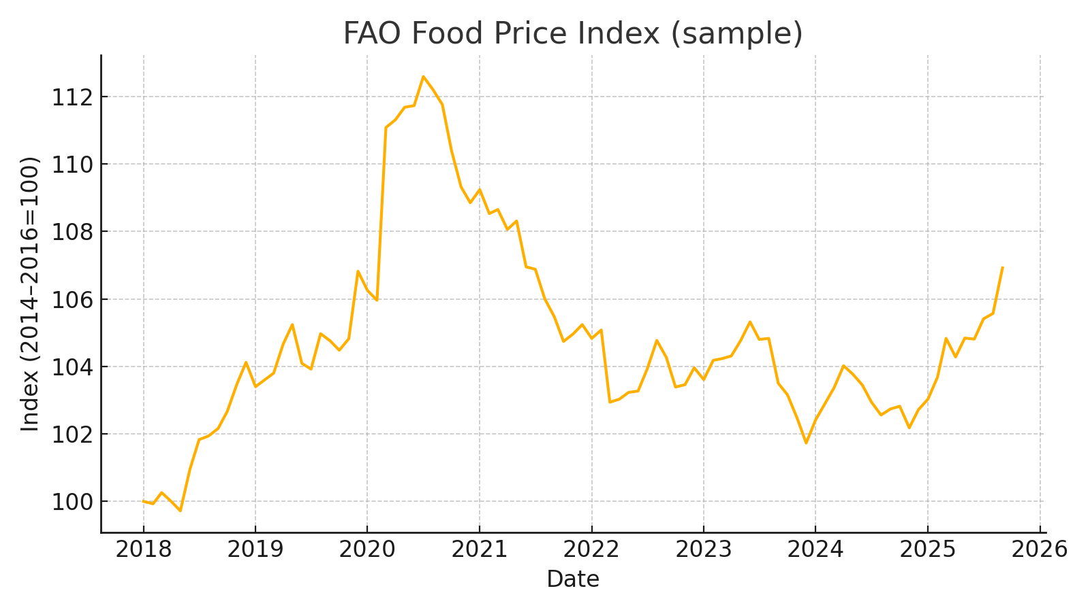
Example figure: Food Price Index
Sample data to illustrate visuals

Slide 11
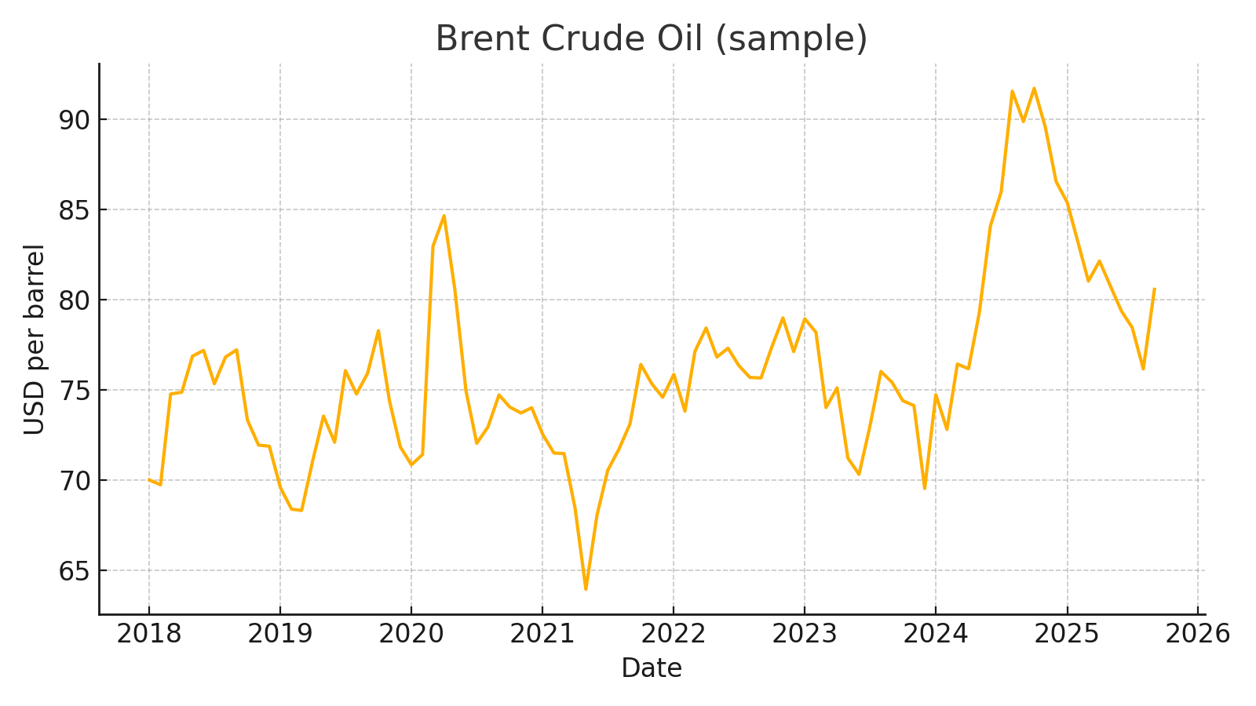
Example figure: Brent crude oil
Sample data to illustrate visuals

Slide 12
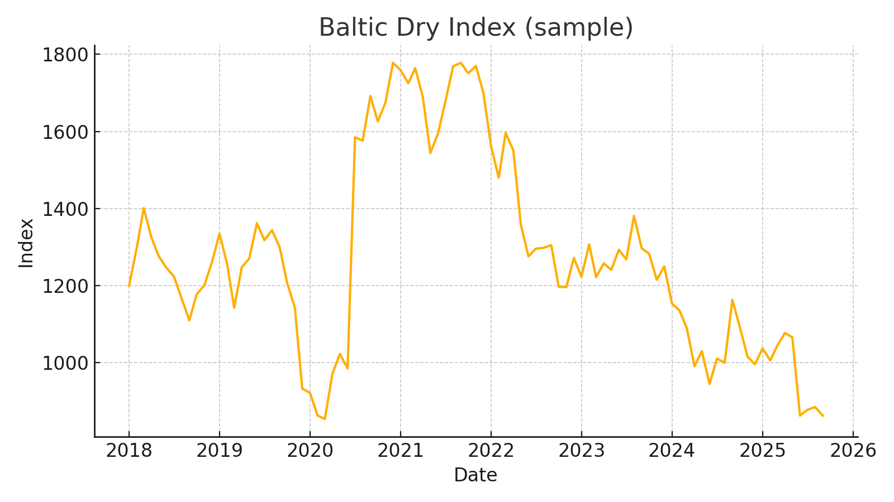
Example figure: Baltic Dry Index
Sample data to illustrate visuals

Slide 13
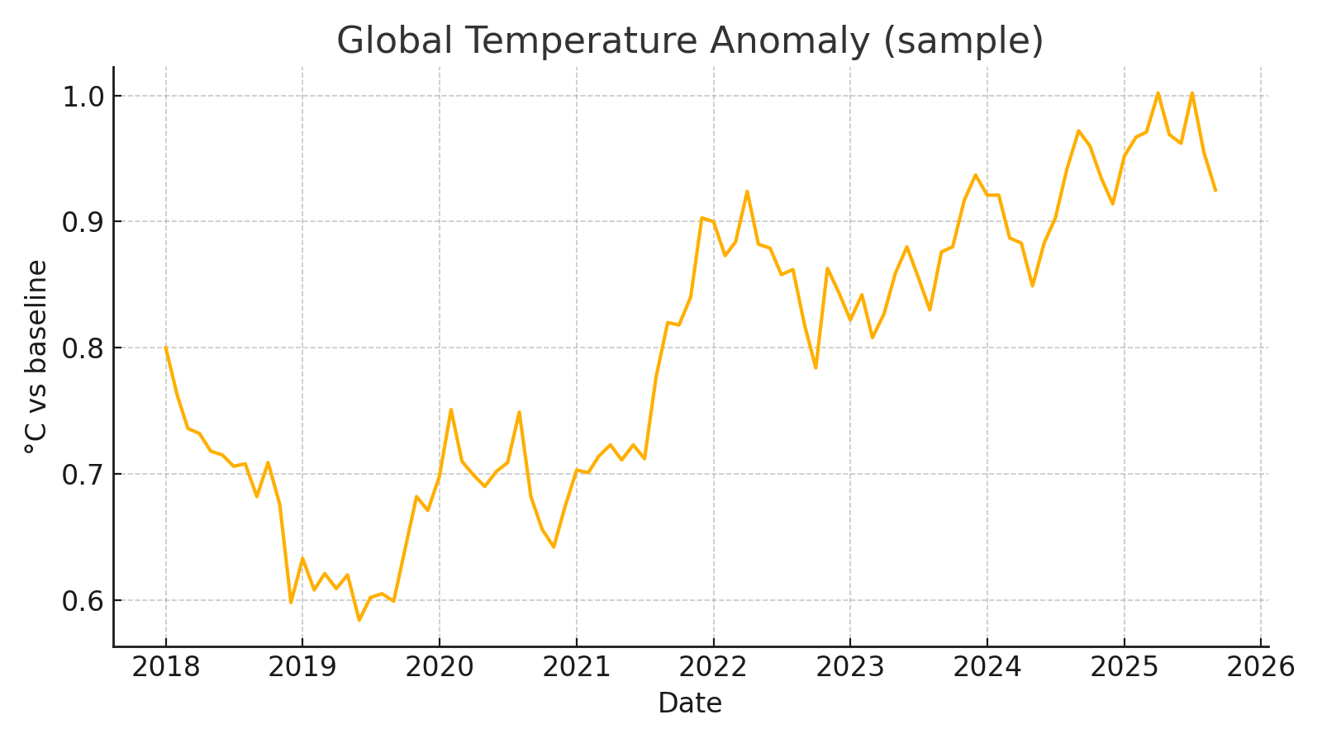
Example figure: Global temperature anomaly
Sample data to illustrate visuals

Slide 14
Quality, risks, and limitations
Source revisions; record vintages and update dates.
Different calendars/time zones; enforce monthly alignment.
Methodology breaks; document metadata and caveats.
Event flags are descriptive; not causal.

Slide 15
Reproducibility & ethics
Scripted pipeline in R; deterministic steps.
Respect licenses; cite providers.
Aggregated indicators only; no personal data.

Slide 16
Out of scope (this deliverable)
No regression or causal claims.
No ML models.
No proprietary/paywalled data.

Slide 17
Summary
Clean, documented, multi‑source dataset ready for analysis.
Slides = summary report; R script rebuilds full dataset locally.
Future: modeling and robustness checks.

